Slide 1
DLA Overview
Briefer, Position
Month DD, YYYY
As of May 2023

Slide 2
Agenda
Video: DLA is...The Nation's Combat Logistics Support Agency
DLA mission, vision and strategic plan lines of effort
DLA: Warfighter Always – Global support
Quick facts
DLA relationships
Who’s Who in DLA
Major subordinate commands
Regional commands
Support organizations
J-codes
DLA as a whole-of-government partner
Wildland Fire and Hurricane support

Slide 3

DLA is … the Nation’s Combat Logistics Support Agency
Notes:
PLEASE NOTE: This video may take a minute to load. It has open captions.
If you have internet access open https://www.dvidshub.net/video/600245/dla-isthe-nations-combat-logistics-support-agency or YouTube and go to: https://youtu.be/hWdJZb3F4NY?t=25
As of June 2022

Slide 4

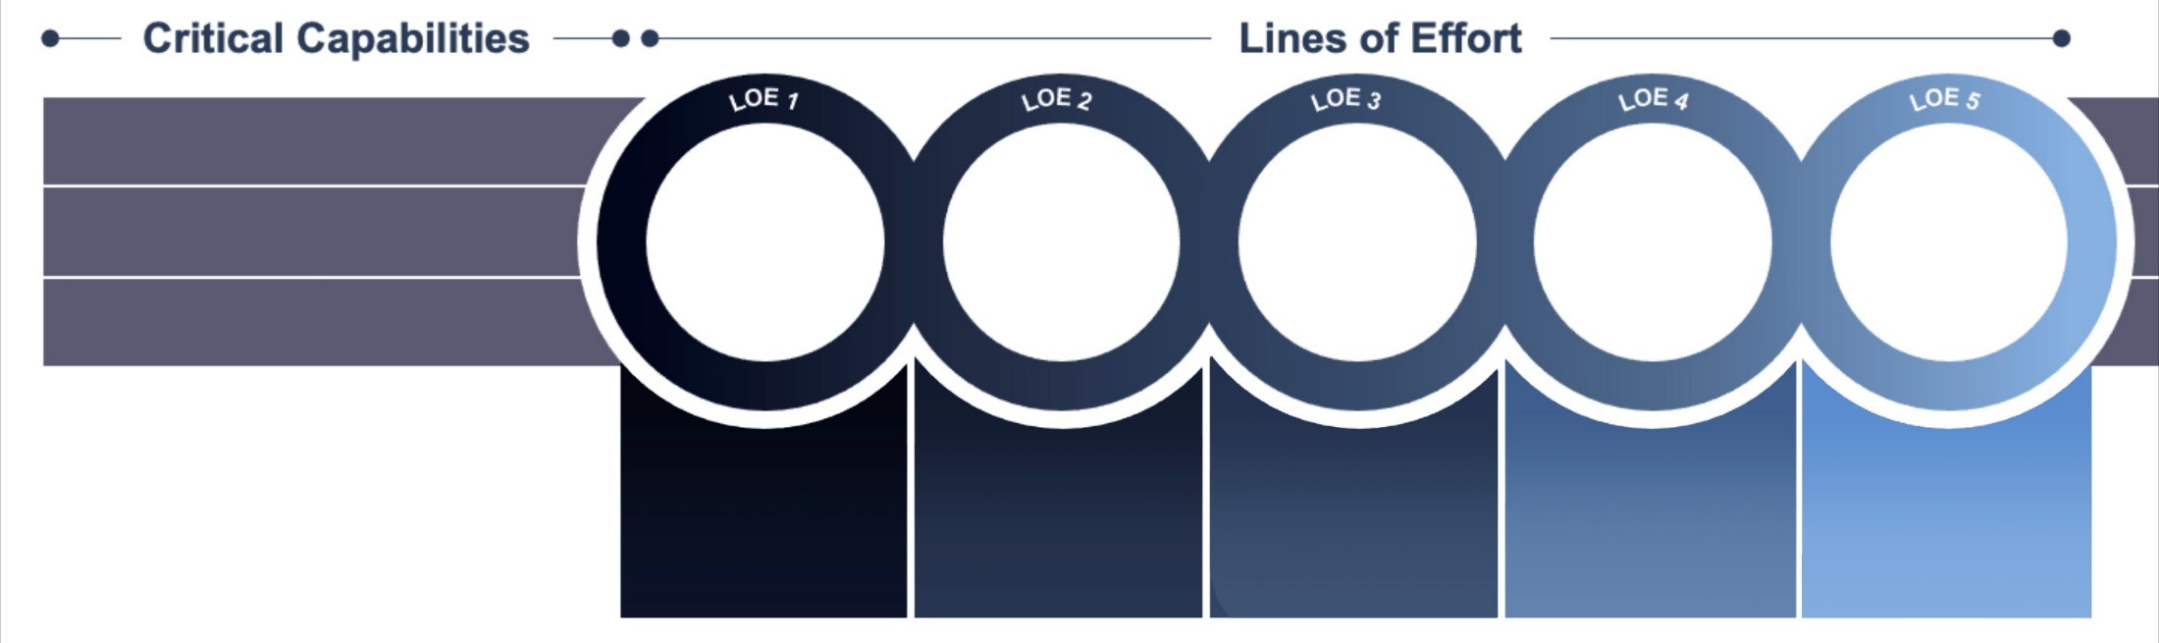
TRANSFORMING GLOBAL LOGISTICS
As the Nation’s Combat Logistics Support Agency, we must lean forward to address new challenges that threaten our global environment. We will meet those threats and the evolving needs of the warfighter and nation with this Strategic Plan, which identifies our most critical priorities and will transform our business processes over the next five years. Though this transformation will not encompass all of DLA’s day-to-day activities, these core objectives will have the greatest impact on our ability to achieve mission success.
MISSION: Deliver readiness and lethality to the Warfighter Always and support our nation through quality, proactive global logistics.
VISION: As the Nation’s Combat Logistics Support Agency and valued partner, we are innovative, adaptable, agile, and accountable – focused on the Warfighter Always.
People & Culture: Supporting our people
Fiscal Stewardship: Investing in outcomes
Warfighter Always
Support to the Nation
Trusted Mission Partner
Modernized
Acquisition & Supply Chain Management
Future of Work
Digital-Business Transformation: Embracing the future
Tailored solutions to drive readiness
Deliberate approach, without tradeoff to the warfighter
Transparency & accountability to our customers
Leading in logistics to deliver best value & manage risk
Adapting to new ways of working
Enterprise Key Performance Indicators (KPI) measure the success of this strategy:
• Service Readiness • Acquisition Timeliness • Liquidity • Customer Satisfaction
• Supply Availability • Business Health • Price Competitiveness • Employee Engagement
Notes:
In April 2021, DLA launched a new strategic plan. The strategic plan meets the evolving requirements of the warfighter and the nation with a targeted transformative approach encompassing the most critical priorities for the next five years. Grounded in the perspectives of customers, DOD partners, and DLA’s workforce, the strategy aligns DLA’s resources and efforts.
DLA’s collaboration with all of its partners is paramount as DLA rapidly innovates at speed and scale to solve problems. DLA will continue to adapt its strategy as needed to reflect the rapidly changing, competitive environment in which DLA operates.
Focusing DLA efforts on these key elements – mission, vision, lines of effort and critical capabilities – enables DLA to address the complexities of today's geo-political environment and the challenges of tomorrow. With a world-class DLA Team working to translate this plan into real results, DLA looks forward to seeing our customers thrive with our support in a demanding and multifaceted world.
Presenters Notes:
Director's Strategic Message Video can be found here: https://www.dvidshub.net/video/789648/vadm-michelle-c-skubic-dla-director-dla-strategic-plan-2021-open-caption
DLA Strategic Plan can be found here: https://go.usa.gov/xH34C
As of June 2022

Slide 5






















DLA: Warfighter Always – Global Support
ARMY
USMC
NAVY
AIR FORCE
SPACE FORCE
USCG
FEMA
USFS
USTRANSCOM
USSTRATCOM
USSOCOM
USCYBERCOM
USSPACECOM
Notes:
As the Nation’s combat logistics support agency, the Defense Logistics Agency manages the end-to-end global defense supply chain – from raw materials to end user disposition – for the five military services, 11 combatant commands, other federal, state and local agencies and partner and allied nations.
DLA sources and provides nearly all the consumable items America’s military forces need to operate, from food, fuel and energy to uniforms, medical supplies and construction material. DLA also supplies the majority of the military’s spare parts, manages the reutilization and disposition of military equipment, provides catalogs and other logistics information products and is DOD’s primary provider of printing services, office print devices and electronic conversion services.
Headquartered at Fort Belvoir, Virginia, DLA is a global enterprise – wherever the nation has a significant military presence, DLA is there to support.
DLA’s major responsibilities are to (1) buy or contract, (2) warehouse when needed, and (3) distribute about 5 million distinct consumable, expendable and reparable items.
DLA acquires items from manufacturers and suppliers that it then provides to DOD and other federal and regional customers, often with supplementary services such as warehousing, packaging and transportation.
DLA also contracts for items that are provided directly by the manufacturer to DLA customers.
As of June 2022

Slide 6

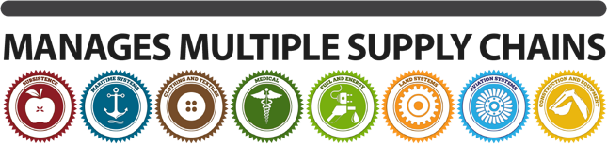
Defense logistics agency quick facts
6 MAJOR SUBORDINATE COMMANDS
• DLA AVIATION
Manages the supply chain for aviation weapons systems repair parts, flight safety equipment, maps, consumable hardware, environmental products and industrial plant equipment.
• DLA TROOP SUPPORT
Manages the supply chains for food, textiles, construction material and medical supplies and equipment, including pharmaceuticals.
• DLA DISPOSITION SERVICES
Disposes of excess property by reutilization, transfer and demilitarization; conducts environmental disposal and reuse.
• DLA LAND AND MARITIME
Manages the supply chain for ground-based and maritime weapons systems repair parts, consumable hardware, small arms parts and fluid-handling systems.
• DLA ENERGY
Manages the supply chain for petroleum and lubrication products, alternative fuel and renewable energy, aerospace energy; provides fuel quality and technical support, fuel card programs and installation energy services.
• DLA DISTRIBUTION
Provides storage and distribution solutions and management, transportation planning and management, logistics planning and contingency operations; operates a global network of distribution centers.
and about
5 MILLION
Line items
AND PROVIDED MORE THAN
$48.2
BILLION
IN GOODS AND SERVICES FOR FY2021
DLA REGIONAL COMMANDS
DLA EUROPE & AFRICA HQ: Kaiserslautern, Germany
The agency’s primary liaison to U.S. European Command, NATO and U.S. Africa Command, providing a unified DLA interface for warfighters throughout the areas of responsibility.
DLA CENTCOM & SOCOM HQ: MacDill Air Force Base, FL
The agency’s primary liaison to U.S. Central Command and U.S. Special Operations Command, providing a unified DLA interface for warfighters throughout the area of responsibility.
DLA INDO-PACIFIC HQ: Joint Base Pearl Harbor / Hickam, HI
The agency’s primary liaison to U.S. Indo-Pacific Command, U.S. Forces Korea, U.S. Forces Japan and U.S. Alaskan Command, providing a unified DLA interface for warfighters throughout the area of responsibility.
Warfighter Always
6
Notes:
DLA Quick Facts:
Employs about 25,000 personnel – military and civilian
Six major subordinate commands – DLA Troop Support, DLA Aviation, DLA Land and Maritime, DLA Energy, DLA Distribution and DLA Disposition Services.
DLA manages multiple supply chains – Subsistence, Clothing and Textiles, Construction and Equipment, Medical, Aviation Systems, Land Systems, Maritime Systems and Fuel and Energy
DLA provided more than $48.2 billion in goods and services for FY2022
Three regional commands – DLA Europe & Africa, DLA CENTCOM & SOCOM and DLA Indo-Pacific
DLA manages the reutilization and disposition of military equipment and operates a global network of distribution centers
As of February 2023

Slide 7
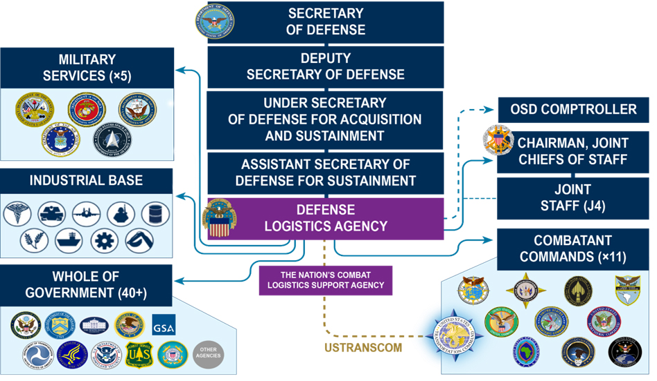
DLA Relationships
7
Notes:
As of June 2022

Slide 8

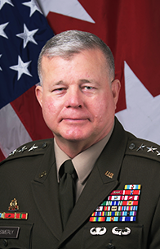

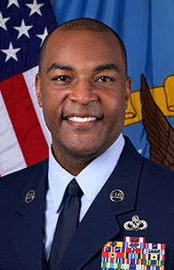

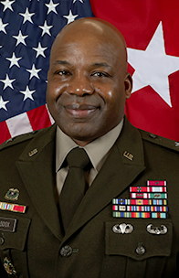

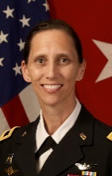
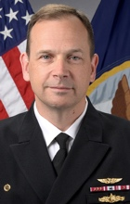


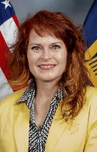


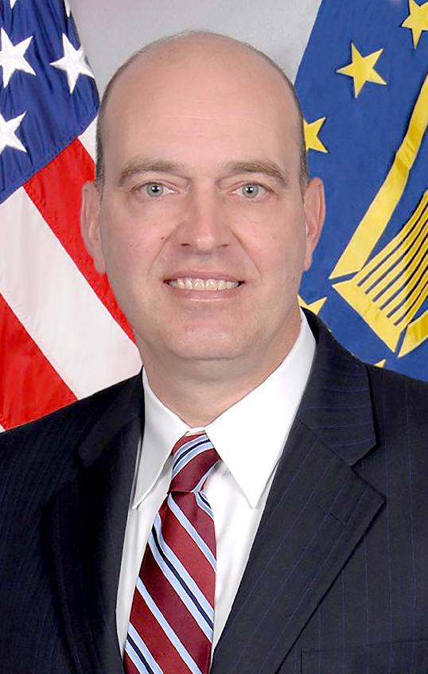





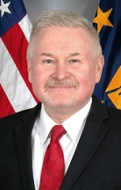

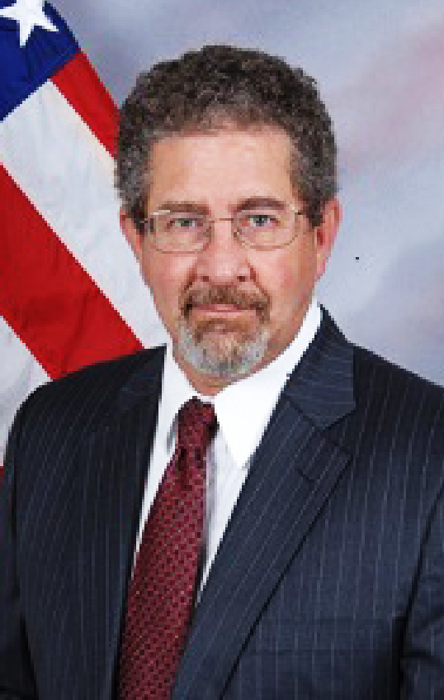


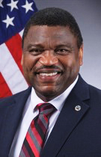
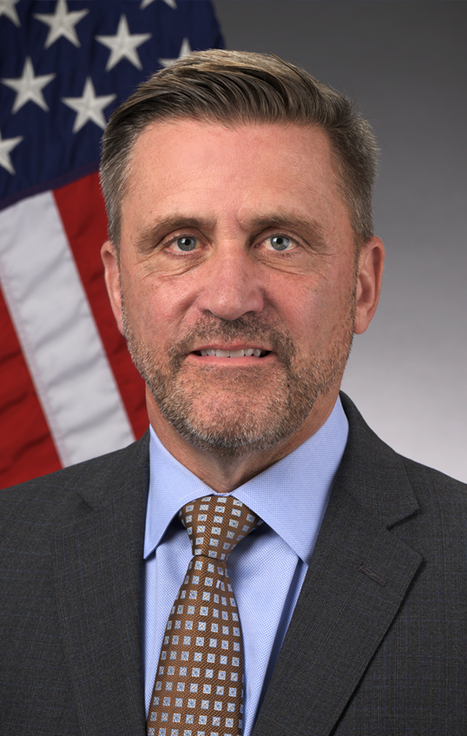

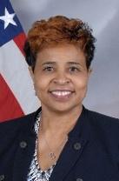

WHO’S
LTG MARK T. SIMERLY, USA DIRECTOR
BRAD BUNN
VICE
DIRECTOR
CCM ALVIN R.
DYER, USAF
SENIOR ENLISTED LEADER
W. ERIC SMITH
CHIEF OF
STAFF
WHO
IN DLA
BG LANDIS
MADDOX, USA
COMMANDER
DLA TROOP SUPPORT
BRIG GEN SEAN
TYLER, USAF
COMMANDER
DLA AVIATION
BG GAIL E.
ATKINS, USA
COMMANDER
DLA LAND AND MARITIME
CAPT BRIAN ANDERSON, USN
COMMANDER
DLA ENERGY
RADM GRAFTON D. CHASE JR., USN
COMMANDER
DLA DISTRIBUTION
MICHAEL O.
CANNON
DIRECTOR
DLA DISPOSITION SERVICES
SHARYN SAUNDERS DIRECTOR
HUMAN RESOURCES
(J1)
RADM JOSEPH D.
NOBLE, USN
DIRECTOR
LOGISTICS
OPERATIONS
(J3)
Adarryl
Roberts
DIRECTOR
INFORMATION
OPERATIONS
(J6)
MATTHEW R.
BEEBE
DIRECTOR
ACQUISITION
(J7)
SUSAN J.
GOODYEAR
DIRECTOR
FINANCE
(J8)
MG TRIPP BOWLES, USA
DIRECTOR
JOINT RESERVE FORCE
(J9)
CAPT PATRICK BLAKE, USN
COMMANDER
DLA
INDO-PACIFIC
COL MICHELLE AGPALZA, USA
COMMANDER
DLA CENTCOM & SOCOM
COL ADRIAN (AJ) SULLIVAN, USA
COMMANDER
DLA EUROPE
& AFRICA
JON LIGHTNER
ACTING DIRECTOR GENERAL COUNSEL
(DG)
VACANT
EXECUTIVE DIRECTOR
SMALL BUSINESS
PROGRAMS
(DB)
WILLIAM A. RIGBY
DIRECTOR
OFFICE OF THE INSPECTOR GENERAL
(OIG)
DONALD PHILLIPS
DIRECTOR
INSTALLATION MANAGEMENT (DM)
CH (COL) THOMAS A. BROOKS, USA
COMMAND
CHAPLAIN
(DH)
ADRAIN CLAY
DIRECTOR
INTELLIGENCE
(DI)
MICHAEL L.
JOHNSON
DIRECTOR
LEGISLATIVE AFFAIRS
(DL)
JOSEPH YOSWA
DIRECTOR
PUBLIC AFFAIRS
(DP)
JANICE SAMUEL
DIRECTOR
EQUAL EMPLOYMENT OPPORTUNITY
(DO)
ALEETA D. COLEMAN
DIRECTOR
TRANSFORMATION
(DT)
8
Notes:
Director—LTG Mark T. Simerly, USN
Vice Director—Mr. Brad Bunn
Senior Enlisted Leader—CCM Alvin R. Dyer, USAF
Chief of Staff—Mr. W. Eric Smith
COMMANDERS, MAJOR SUBORDINATE COMMANDS
Commander, DLA Troop Support—BG Landis Maddox, USA
Commander, DLA Aviation—BRIG GEN Sean Tyler, USAF
Commander, DLA Land and Maritime—BG Gail E. Atkins, USA
Commander, DLA Energy—CAPT Brian Anderson, USN
Commander, DLA Distribution—RADM Grafton D. Chase Jr., USN
Director, DLA Disposition Services—Mr. Michael Cannon
J CODES
Director, Human Resources—Ms. Sharyn Saunders
Director, Logistics Operations—RADM Joseph D. Noble, USN
Director, Information Operations—Mr. Adarryl Roberts
Director, Acquisition—Mr. Matthew Beebe
Director, Finance—Ms. Susan J. Goodyear
Director, Joint Reserve Force—MG Tripp Bowles
COMMANDERS, REGIONAL COMMANDS
Commander, DLA Indo-Pacific—CAPT Patrick Blake, USN
Commander, DLA CENTCOM & SOCOM—COL Michelle Agpalza, USA
Commander, DLA Europe & Africa—COL Adrian (AJ) Sullivan, USA
STAFF
Acting Director, General Counsel—Mr. Jon Lightner
Director, Small Business Programs—Vacant
Director, Inspector General—Mr. William Rigby
Director, Installation Management—Mr. Donald Phillips
Command Chaplain—Chaplain (COL) Thomas A. Brooks , USA
Director, Intelligence—Mr. Adrain Clay
Director, Legislative Affairs—Mr. Michael L. Johnson.
Director, Public Affairs—Mr. Joseph Yoswa
Director, Equal Employment Opportunity—Ms. Janice Samuel
Director, Transformation—Ms. Aleeta D. Coleman
As of February 2024

Slide 9
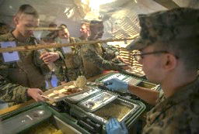
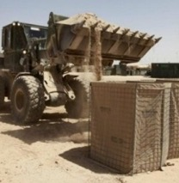
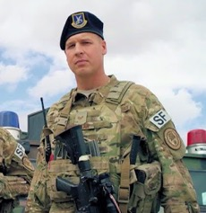
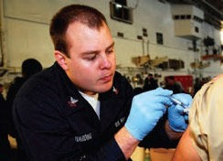
DLA Troop Support Philadelphia, PA
Provides food, uniforms, protective equipment, construction items, medicines and medical supplies to warfighters and customers around the world
SUBSISTENCE: CLASS I
CONSTRUCTION & EQUIPMENT: CLASS IV & VII
Garrison feeding
Produce and market ready
Operational rations
Food prep/field feeding equipment
Facilities maintenance
Equipment
Wood products
Safety and rescue equipment
CLOTHING & TEXTILES: CLASS II
MEDICAL: CLASS VIII
Field and dress clothing
Recruit clothing
Body armor
Organizational clothing and individual equipment
Equipment and tentage
Pharmaceuticals
Medical surgical supplies
Hospital equipment/ supplies
Capital equipment
Assemblies/kits
Notes:
DLA Troop Support provides U.S. service members with food, clothing, textiles, construction supplies and equipment, medicines, and medical equipment. They also support other federal agencies, and humanitarian and disaster relief efforts around the world.
The Subsistence supply chain provides food support for the military all over the world. This supply chain serves as the key link between the Armed Forces and the U.S. food industry. It also provides support to other federal agencies, the Veterans Administration, Public Health Service hospitals, the USDA's National School Lunch Program, and the District of Columbia School District.
The Clothing and Textiles supply chain provides clothing, textiles, and equipment to U.S. service members, other federal agencies, and partner nations. C&T procures more than 8,000 different items from uniforms, footwear, and undergarments to ecclesiastical items, individual equipment, flags and tents.
The Construction and Equipment supply chain supplies items for force protection, safety and rescue, fire and emergencies, storage, HVAC, plumbing, heavy equipment, metals and lumber, as well as marine life saving and diving equipment, imaging and telecommunication devices, targets for training, and automated data processing equipment and supplies.
The Medical supply chain provides medical products and services needed every day for every crisis around the world. Support includes surgical items, preventive vaccines, field hospital equipment as well as medical supplies for animals.
As of June 2022

Slide 10


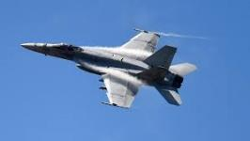

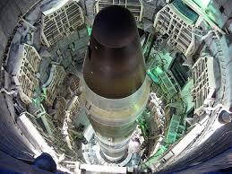
DLA Aviation Richmond, VA
Provides global airpower supply solutions
AVIATION: CLASS IX
OPERATIONAL AND INDUSTRIAL SUPPORT
Turbine engine components
Air frame structural parts
Flight safety equipment
Electrical components
Aviation lighting
Bearings
Commodities
Cables
Hardware
ADDITIONAL DLA AVIATION SERVICES
Maps
Environmental products
Packaged petroleum
Industrial gases
Industrial plant equipment
Notes:
DLA Aviation employs more than 4,000 civilian and military personnel in 18 locations across the United States. We provide aviation weapons systems and environmental logistics support to the defense aviation community and other governmental customers. DLA Aviation supports more than 13,500 joint aircraft, 450 intercontinental ballistic missiles, and host of other weapons systems, and is the U.S. military’s integrated material manager for more than 1.7 million national stock number items, industrial retail supply and depot-level reparable acquisitions.
A proven performer, DLA Aviation had $4,943 billion in sales during fiscal year 2021, processed 3.9 million customer orders during the year; and conducted business with more than 3,400 suppliers as part of its support to its 12,287 customers.
DLA Aviation’s primary mission is to support the warfighter by providing Aviation repair parts and components to include engine components, airframe structural parts, flight safety equipment, electrical components, lighting, bearings, cables, and other commodity items.
DLA Aviation is responsible for supply at six major industrial maintenance, repair, and overhaul facilities, and for storage operations at three. DLA Aviation also operates five depot-level reparable procurement organizations.
DLA Aviation delivers unique customer support capabilities through its Industrial Plant Equipment Services and Mapping Customer Operations Divisions. IPES operates the only industrial plant equipment management facility and maintenance depot in the federal government dedicated to procuring, rebuilding, retrofitting, and repairing metalworking machinery for the Department of Defense and other federal agencies. Mapping Customer Operations provide exceptional supply and demand chain support by providing aeronautical, digital, hydrographic, and topographic maps to geospatial intelligence customers.
DLA Aviation plays a pivotal role in supporting our soldiers, Marines, sailors, airmen, and other customers by providing targeted solutions and full-spectrum logistics support.
DLA Aviation also provides some unique services to warfighters and other customers such as FEMA, Department of the Interior, etc.
These unique services include:
The DLA HAZMIN and Green Products team under the Aviation Supply Chain’s Engineering Directorate has the mission to support DOD’s Sustainability Policy by helping DLA’s military customers to “Buy Green.” The team provides technical assistance and logistics guidance to its military service customers with respect to Pollution Prevention Programs, Green Products, and overall sustainability issues.
Examples include: Recycled content products, Less toxic and low VOC products, Energy and water-conserving products, Bio-based products, and alternatives to hazardous items such as lead, mercury and cadmium.
The ODS Reserve is DOD's central manager for the turn-in, storage, reclamation and issuance of mission-critical ODS for all of the military services and the Coast Guard. The Reserve provides the DOD the capability to recover and centrally receive, reclaim, store and issue ODS.
The Hazardous Materials Information Resource System (HMIRS) is the central repository for information on hazardous materials used by DOD. HMIRS is an automated system containing Safety Data Sheets (SDS) information and item-specific value-added data such as transportation, logistics, and disposal procedures and OSHA-compliant hazardous warning label information. HAZMAT HELPLINE provides technical assistance on day-to-day regulated materials issues via a helpline through web, e-mail, or telephone in the areas of Environment, Occupational Safety & Health, Transportation, Packaging, Storage-Handling, Pollution Prevention, and Logistics.
As of July 2022

Slide 11
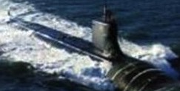
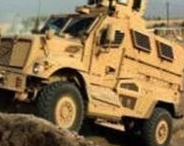
DLA Land and Maritime Columbus, OH
Provides global Land and Maritime supply chains
LAND: CLASS IX
MARITIME: CLASS IX
Wheeled, tracked and heavy vehicle parts
Vehicle maintenance kits
Power transmission, engine and suspension components
Tires
Batteries
Small arms parts
Valves
Fluid handling
Electrical/electronics
Motors
Packing/gaskets
CONSUMABLE HARDWARE: CLASS IX
Consumable repair parts
Fastening devices
Miscellaneous hardware
Notes:
Throughout the world, DLA Land and Maritime is known to more than 25,000 military and civilian customers and 10,000 contractors, as one of the largest suppliers of weapons systems spare parts.
DLA Land and Maritime manages 2 million items, awards more than 322,000 contracts annually, supports nearly 1,800 weapons systems, and handles more than 9 million orders annually, with annual sales topping $4 billion.
Land and Maritime was the first inventory control point in DLA to develop a weapons systems approach toward materiel management. Weapons systems management is now standard procedure in DLA, and Land and Maritime is the lead ICP for land, maritime and missile weapons systems.
Today, having transformed from being a wholesaler to an end-to-end supply chain manager, DLA Land and Maritime's state-of-the-art systems connect business processes from the supplier to the customer through the Land and Maritime supply and demand chains.
As of June 2022

Slide 12
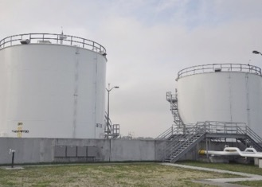
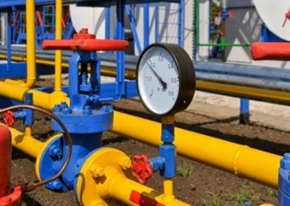
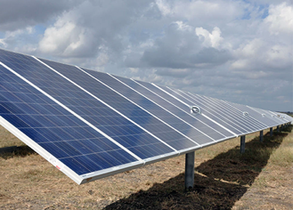
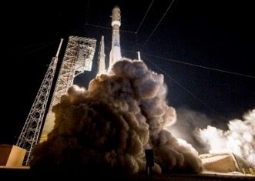
DLA Energy Fort Belvoir, VA
Globally resilient Energy solutions for the warfighter and whole of government
PETROLEUM, OIL & LUBES: CLASS III
ENERGY SERVICES & COMMODITIES
DOD Executive Agent and DOD Integrated Materiel Manager for all bulk petroleum
Commercial and MILSPEC fuels
Storage, laboratory, and alongside aircraft refueling support
End to end supply chain management
Fuels international agreements
Aerospace energy
Bulk liquid propellants, cryogenics, specialty chemicals, and gases
Installation energy
Natural gas, electricity, renewable power, energy savings performance contracts
Utilities system privatization
Notes:
DLA Energy provides energy to the military services, the Department of Defense and other federal agencies at more than 4,000 locations worldwide. In fiscal year 2021, DLA Energy recorded approximately $8.8 billion in sales and issued a total of 3.7 billion gallons of fuel. In addition, $740M in Whole-of-Government support, $872.8M sold via Fuel Card Program.
DLA Energy procures petroleum products – jet fuels, aviation and automotive gasoline, heating oil and lubricants.
In addition to providing extensive contracting and technical support for the privatization of installation utility systems, including electric, natural gas, water and wastewater systems, DLA Energy performs the centralized contract administration function for the utility service contracts, which can last up to 50 years.
DLA Energy supports commodities and services including coal, natural gas, electricity, renewable energy, energy savings performance contracts and long term renewable energy project development.
DLA Energy Aerospace Energy manages the worldwide acquisition of missile and rocket fuels, propellants for systems to include satellites and aerostats, as well as aviator’s breathing oxygen and other bulk industrial gases.
As of June 2022

Slide 13
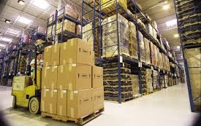
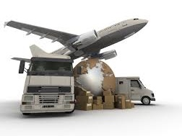
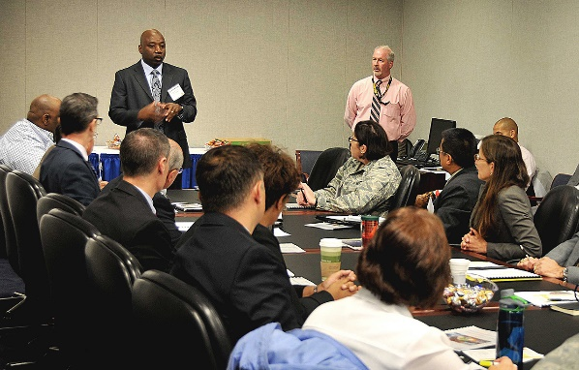
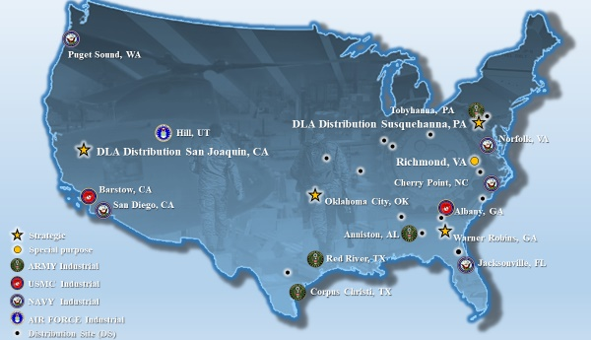
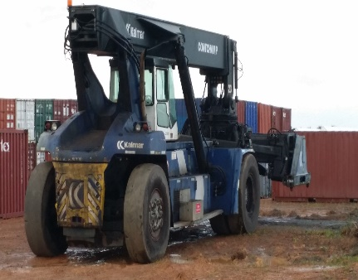
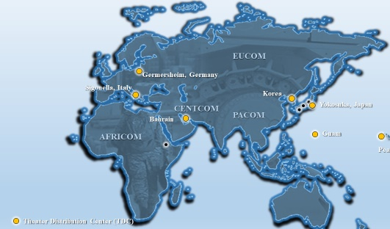
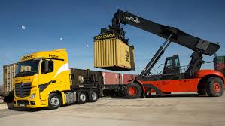
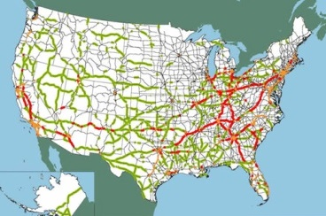
DLA Distribution New Cumberland, PA
DOD’s joint storage and distribution provider
Storage & Distribution Functions
Transportation Planning & Management
Customer Service
Wholesale and retail receipt, store, issue material
Inventory
Preservaton, packaging, packing and marking
Coordination of transportation requirements for DLA S&D locations & vendors
Materiel movement tracking & expediting
LOCATIONS
20 STATES
24
DISTRIBUTION
CENTERS
7 COUNTRIES
41
OTHER LOCATIONS
Storage & Distribution Program Management
Logistics Planning & Contingency Ops
Performance
Acquisition
Infrastructure
Equipment
Safety
Compliance
Deployable Distribution Center
Contingency S&D Contracts
Flexible support for surge needs
Fluid Workforce
Notes:
DLA Distribution employs almost 10,000 people and has more than 50 locations worldwide. Those locations include distribution centers, an expeditionary team that serves as a mobile distribution center, consolidation and containerization points, theater consolidation and shipping points, materiel processing centers, recruit training centers and meals ready to eat storage sites.
DLA Distribution supply centers manage materiel and offer services including storage, distribution, custom kitting, specialized packaging as well as transportation support and technology development—all aimed at increasing warfighter readiness. The centers and sites have more than 2.5 million item numbers in stock worth more than $138 billion.
In fiscal year 2021, DLA Distribution had more than 17.4 million global transactions.
As of June 2022

Slide 14
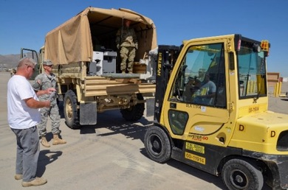
DLA Disposition Services Battle Creek, MI
Provides worldwide reverse logistics solutions
Reutilization (military services and DOD)
Special programs
Transfer (to federal agencies)
Donation (to state and local agencies)
Sales of excess DOD property
Contingency operations support
Demilitarization
Hazardous waste disposal
Law Enforcement Support Office
Notes:
DLA Disposition Services plays a large role in the reuse or disposal of materiel no longer required by military forces, both usable items and scrap. DLA Disposition Services sites are on military installations at home and abroad.
The activity accepts excess usable items from military units and facilitates its reuse by other military units, transfers appropriate materiel to other federal agencies or donates it to state and local governments.
Under special programs, schools across the country can acquire excess computers and other IT technology for free. Working with the U.S. Forest Service, Disposition Services provides free vehicles and equipment to firefighters. The congressionally established Law Enforcement Support Office program provides certain types of equipment to law enforcement agencies when approved by their states and local governing authorities.
Excess items also support disaster relief, humanitarian missions, foreign military sales, and homeless veterans programs operated by VA medical centers.
Some excess items are sold to the public after all eligible recipients have passed on them. The sales revenue helps offset the overall cost of military logistics.
To provide direct operational support, it also maintains a contingency response capability using trained and tested teams of civilians and military personnel. Their mission is to provide property disposal under austere conditions using prepositioned equipment sets.
The activity also helps military units achieve environmental stewardship by taking care of their hazardous waste. Under the oversight of DLA environmental specialists, qualified and licensed contractors pick up the hazardous waste from military bases and transport and dispose of it in a compliant manner.
As of June 2022

Slide 15


DLA Regional Commands
DLA Europe & Africa
DLA Indo-Pacific
DLA CENTCOM & SOCOM
Three Regional Commands supporting five Combatant Commands
U.S. European Command & U.S. Africa Command
U.S. Central Command & U.S. Special Operations Command
U.S. Indo-Pacific Command
Single focal point for DLA support to the Combatant Commands
DLA lead for theater contingency/exercise planning
Responsible for DLA Support Teams
Notes:
We are structured to support the warfighter across the world.
To provide a single face to customers in U.S. European, Africa, Central, Special Operations and Indo-Pacific Commands, and improve the alignment and authorities of the DLA regional commanders, we’ve postured our major subordinate commands under a single regional commander. This arrangement streamlines our customers’ interaction and provides unified and responsive support in the theater of operations.
DLA Europe & Africa, DLA CENTCOM & SOCOM and DLA Indo-Pacific each provide a single DLA interface/focal point to the geographic combatant commanders, integrating DLA support throughout the areas of responsibility.
We support the other combatant commands through liaisons that are collocated and interface with:
– U.S. Northern Command (USNORTHCOM) in Colorado Springs, Colorado (Peterson Air Force Base)
– U.S. Southern Command (USSOUTHCOM) in Miami, Florida
– U.S. Strategic Command (USSTRATCOM) in Omaha, Nebraska (Offutt Air Force Base)
– U.S. Transportation Command (USTRANSCOM) (Scott Air Force Base)
As of June 2022

Slide 16
DLA Support Organizations
Nuclear and Space Enterprise Support Office: Synchronizes the agency’s efforts and resources to ensure responsive material support to the DOD Nuclear Enterprise, DOD Space Enterprise, and its strategic warfighters.
Strategic Materials: Acquisition, storage, sale, recycling and conversion of the critical raw materials operation and oversight of the national defense stockpile.
Enterprise IT solutions: Develop, deliver and sustain a full range of combat support IT solutions and data services for DLA and DOD to include document management, research and development and infrastructure/software as a service/cloud.
Notes:
These are other services that DLA performs, all necessary in supporting national defense.
The Nuclear & Space Enterprise Support Office synchronizes processes and procedures necessary to optimize Nuclear Enterprise (NE) and Space Enterprise (SE) support, sustainment, and modernization efforts. Provides NE/SE customer materiel requirements for Combatant Commands and Military Services. Ensures DLA-managed materiel is not a limiting factor for NE/SE warfighters by intensively managing inventory investment to satisfy customer requirements. NESO functions as DLA's lead organization to the Department of Defense (DOD) and Department of Energy (DOE) Nuclear Enterprise (NE) and the Space Enterprise (SE) by synchronizing DLA policy, planning, resourcing, and procedures supporting United States Navy, United States Air Force, United States Space Force, Joint Chiefs of Staff, and OSD organizations with strategic national, strategic theater, and operational responsibilities supporting the DOD NE and SE. Responsible for analyzing and integrating responsive sustainment and support efforts with external customers, identifying and resolving gaps and shortfalls in NE and SE support, overseeing handling of Nuclear Weapons Related Material, and monitoring the health, capability, and performance of DLA systems supporting the NE and SE. Collaborates with NESO LNOs located with USSTRATCOM, USSPACECOM, USSF, AFGSC, AFNWC and NESO teams across DLA Major Subordinate Commands. Coordinates readiness requirements with DLA's Agency Synchronization Operations Center. Guides strategic engagement and collaboration with internal DLA stakeholders at headquarters and field level. Supports strategic stakeholder engagements with OSD entities, the Joint Staff, Geographic Combatant Commanders, Functional Combatant Commanders, Service Component Commands, Title 10 Service force providers, and other organizations within the DOD NE and SE, to include providing DLA planning support for plans developed in support of the National Military Strategy and the National Security Strategy. Works with officials of the Military Services' Headquarters and their operations and sustainment commands to collaborate on and resolve NE and SE shortfalls.
Strategic Materials falls under DLA Acquisition (J7) and has the primary mission to plan, facilitate, and acquire services and supplies necessary to support the storage and sale of its strategic and critical materials inventory located in depots throughout the U.S. Examples are: chromium, platinum, germanium, beryllium, titanium and mercury.
The J6 provides a variety of services for DLA and DOD to include:
Enterprise IT solutions: Develops and delivers a variety of IT solutions and data services.
Document Management: Provides document automation products and services to the DOD and designated federal activities, including imaging and conversion of documents to electronic media, digital warehousing, and distribution of digital and hardcopy information. DLA Document Services is the single manager for all DOD printing and duplicating.
Research & Development: Provides world-class R&D efforts, using internal/external partnerships, rapid prototyping and technology adoption, and flexible processes, focusing on supply chain logistics risks to address industrial base manufacturing issues.
Infrastructure services: Delivers a full range of IT infrastructure solutions in support of DLA operations; providing reliable IT infrastructure for all applications, systems and users ensuring adequate availability for mission completion, and serve as the Agency's application hosting expert supporting both the movement of applications to the cloud and data center consolidation initiatives.
As of June 2022

Slide 17

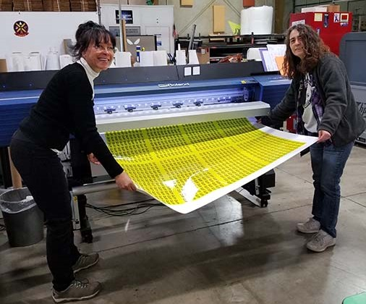
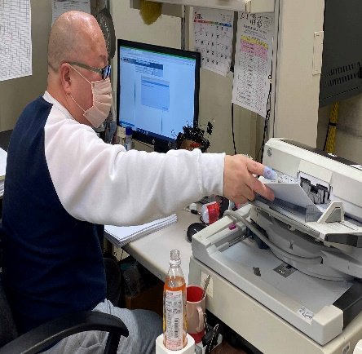
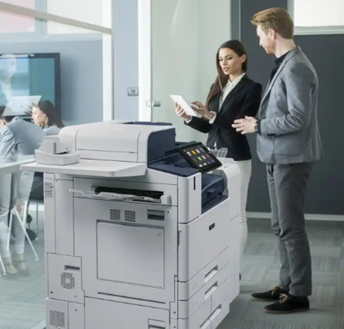
DLA Document Services
Per DoDI 5330.03, all DOD components should be using DLA Document Services for printing services, scanning/conversion and procuring office devices.
Print Services
Brochures, training manuals, banners, aircraft decals etc. with a variety of custom and specialty materials available.
Scanning & Conversion
Technicians can convert documents of all sizes to electronic format for easy search and retrieval
Office Device Management
Procurement, delivery and sustainment of office devices including office, desktop and stand-alone printers as well as copiers, fax machines, scanners and multi-function devices.
Contact Us
https://www.dla.mil/Document-Services/
Call: 1-866-736-7010
Email: contact.docsvcs@dla.mil
Notes:
DLA is now the Defense Department’s primary provider of printing services, office print devices and electronic conversion services according to a DOD instruction signed by the Under Secretary of Defense for Acquisition and Sustainment.
Department of Defense Instruction 5330.03 establishes policy and assigns responsibilities to DLA as the single manager of document services in the DOD.
The instruction directs DOD components to solely use DLA Document Services for production printing, procuring office multifunctional devices and scanning and conversion – unless their requirements qualify for an exception.
DOD components include: OSD, the Military Departments, the Office of the Chairman of the Joint Chiefs of Staff and the Joint Staff, the Combatant Commands, the DOD Office of the Inspector General, Defense Agencies, DOD Field Activities and all other organizational entities within the DOD. Excluded: DOD intelligence agencies, National Guard and Reserve organizations, tactical activities and the U.S. Army Print and Media Distribution Center.
Use of DLA’s services will eliminate duplicate efforts and allow DOD components to focus on their core missions.
Document services consolidation under the updated policy will reduce costs for DOD and return scarce funding for other DOD priorities, potentially tens of millions of dollars each year.
DLA Document Services provides:
- Procurement (lease or purchase), delivery and sustainment of office printing devices, desktop and stand-alone printers, copiers, fax machines, scanners and multi-function devices.
- Production and delivery of unclassified, official use only, personally identifiable information, controlled unclassified information and classified (up to the Secret level) printed products in hard copy, such as banners, decals, technical manuals and other hard copy publications that cannot be economically produced on office printing devices.
- Production and delivery of documents in electronic form through document scanning or conversion of files to standard electronic formats that can be opened, viewed or edited using a software program on a computer.
DLA Document Services evaluates and delivers effective document service capabilities based on best value, as determined by the quality, price and delivery time, in coordination with customer requirements.
DLA Document Services has been providing professional document services for more than 70 years with the highest quality and customer service.
As of June 2022

Slide 18

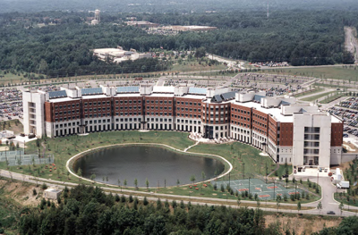
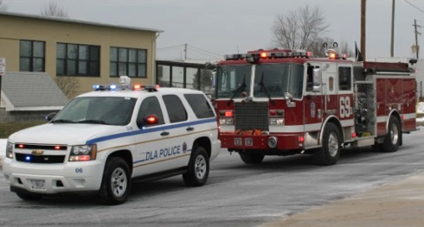
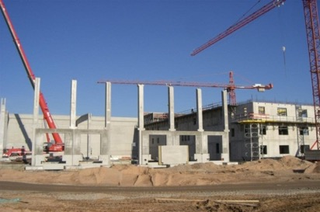
DLA Installation Management
DLA Installation Management provides policy and operations for specialized support services to DLA Major Subordinate Commands, J/D Codes and tenant organizations to include:
Facilities and Equipment
Security and Emergency Services
Environmental Management
Installation Management
Family and Morale, Welfare, and Recreation
Notes:
DLA Installation Management—Policy provides policy and oversight for specialized support services to DLA.
Facilities and Equipment: Responsible for military construction, real property maintenance activities, military family housing, energy resource management, facilities master planning, real estate, administrative space management, operating equipment and motor vehicles, property accountability, retail supply policy, and engineering support program.
Security and Emergency Services: Responsible for all DLA police and fire departments.
Environmental Management: Responsible for providing Agency-wide policy, program, and operational support in the areas of environmental compliance, restoration and sustainability.
Safety and Occupational Health: Provides policy, guidance, and oversight for the Agency Occupational Safety and Health Program.
Process Management: Provides guidance and directions to employees to document enterprise processes, test controls, correct deficiencies and ensure the numbers are traceable and proof exists to achieve auditability.
DLA Installation Management—Operations provides DLA with the installation capabilities and services to support the DLA mission.
Quick Facts: There are 2,071 General Schedule/Wage Grade/Non-appropriated Fund civilian employees which includes 480 police officers and firefighters. There are also 250 contract employees supporting the organization.
Manages more than 17,000 real property assets at more than 600 locations. Examples include land, buildings, structures, utilities systems and includes equipment attached to and made part of buildings and structures (such as heating systems).
Manages more than 18,000 general equipment assets. Examples include forklifts, servers, copy machines, trucks, and video conferencing equipment.
Manages more than 2,500 capital equipment assets, which are the same as general equipment assets with a value of more than $250,000
Manages five child development centers located at Fort Belvoir, Virginia; Richmond, Virginia; Columbus, Ohio; Susquehanna, Pennsylvania and San Joaquin, California.
Supports DLA Distribution Centers and DLA Disposition Services sites located worldwide.
Installation Operations site directors are co-located with DLA MSCs and DLA regional commanders.
As of June 2022

Slide 19

DLA Human Resources (J1)
DLA Human Resources (J1) finds, hires, trains, and sustains a mission-ready workforce for DLA using world class polices, processes, programs, and tools. Within DLA, J1 provides:
Strategic position management, recruitment and placement
HR and performance management policy
Pay and travel administration and policy
Benefits counseling and administration
Labor management and employee relations
Leadership development, career management, and training
Military personnel administration
Organizational culture/climate program management
DLA J1 also provides HR management and services for other
defense organizations and commands through the DOD customers team.
Our Mission: Ensure a mission-ready workforce to support America’s
warfighters while setting the standard for people and culture innovation.
Notes:
DLA recognizes a high-performing, valued, resilient and accountable workforce is vital to current and long-term success in effectively supporting the warfighter.
J1, DLA Human Resources, advises and assists the DLA Executive Board in building and sustaining an exceptional civilian and military workforce within DLA. In support of the DLA mission, DLA Human Resources finds, trains, and sustains a mission-ready workforce for DLA and our HR customers, using world class policies, processes, programs, and tools.
In addition to providing full HR support to DLA, J1 provides HR services to other DOD agencies on a reimbursable basis.
J1’s mission entails developing a strategic approach and requisite policies/programs in the areas of: talent management, leadership development, change management, personnel staffing, position classification, employee relations, labor relations, training, executive development, career management, pay administration, performance management, incentive awards, injury compensation, certain worker/family support programs, employee assistance program, sexual assault prevention and response, management information, military personnel, military manpower management, and the DLA Senior Executive Service Program.
J1 oversees the provision of services by the DLA Human Resources Services, DLA customers; Enterprise Operations; DLA Payroll and Travel; Human Resources Information Systems; Military Personnel; DLA Training; Workforce Development Policy and Program Support; and DOD customers.
As of June 2022

Slide 20
DLA Logistics Operations (J3)
J3 is responsible for end-to-end supply chain management of DLA’s multiple supply chains, monitoring supply chain performance and providing logistics policy, guidance and oversight. The J3 team engages and advocates for customers to maximize readiness and combat logistics support by leveraging enterprise solutions. The Director of Logistics Operations also serves as the commander of joint regional combat support, directing DLA’s three Regional Commands.
Serves as the principal strategic, operational and tactical planner for DLA business operations and champions best business practices
Operates the DLA Agency Synchronization Operations Center, which plans, monitors, tasks and integrates the DLA response to operations and contingencies
Manages the Nuclear and Space Enterprise Support Office and the Customer Interaction Center
Coordinates daily operation of DLA’s six major subordinate commands
Responsible for DOD and international cataloging policy, procedure and execution
Notes:
J3, DLA Logistics Operations, is responsible for end-to-end supply chain management of DLA’s multiple supply chains. J3 provides logistics and materiel process management policy, guidance and oversight while conducting continuous assessments of supply chain performance.
J3 is the critical link to military service customers and the combatant commands for the entire Agency. This directorate links DLA’s vast sustainment capabilities to warfighter demand in order to deliver end-to-end supply chain effectiveness.
J3 functions as the strategic and operational focal point to:
– Build mutually beneficial partnerships with every DOD component
– Establish and execute measurable performance agreements
– Collaboratively manage DLA account plans for each military service
– Develop engagement strategies for each service
– Cultivate new opportunities for DLA support
Additionally, the J3 integrates DLA support for the DOD enterprise, synchronizing responsibilities for all the related policy and procedures, monitoring the health, capability, and weapons systems performance for this mission set, and working with the Military Service Headquarters on weapons system support improvement initiatives.
The J3 also manages expeditionary missions including the Global Response Force Rapid Deployment Teams, in addition to the traditional DLA Support Teams.
J3 Background:
– Acts as a customer advocate for the Agency, maintaining close relationships with our stakeholders through regional commanders, deployed support teams, combatant command and major mission area liaison officers and customer service representatives
– Serves as DLA’s primary focal point for new supply chain concepts, proposals, initiatives and assessments
– Executes strategic planning and analysis and recommends operations, business processes, information systems and policy improvements to synchronize and improve end-to-end performance of supply chains
– Operates the DLA Agency Synchronization Operations Center, which monitors, tasks and integrates the DLA response to operational and contingency requirements
– Plans, conducts and participates in joint exercises
– Supports worldwide humanitarian relief efforts
– Synchronizes responsibilities for all Nuclear Enterprise-related policy and procedures
– Assists the combatant commands with executing their Operational Contract Support mission
– Houses the Center of Planning Excellence, the PBL Center of Excellence, and the Customer Interaction Center
– Advocates for the MSCs and oversees their activities
– Oversees the DLA foreign visitor program
As of June 2022

Slide 21

DLA Information Operations (J6)
J6 leads and manages the confluence of information and technology as DLA embarks on a Digital-Business Transformation to provide innovative logistics IT to support effective warfighter outcomes.
Considers day-to-day operations as job #1
Sets strategic direction for IT at DLA
Designs and delivers IT capabilities that power the DLA Business
Delivers a seamless and secure IT experience
Manages data as a strategic asset
Shapes an IT culture of resilience and adaptability
Operates the IT infrastructure and manages the IT portfolio
Aligns technology to customer needs and agency priorities
Trains and oversees IT professionals
Monitors and protects DLA’s network and IT assets
Notes:
J6, DLA Information Operations, leads and manages the confluence of information and technology for DLA, providing comprehensive, best practice Information Technology support to the DOD/DLA logistics business community. J6 also provides high quality information systems, customer support, efficient and effective computing, data management, electronic business, telecommunication services, and secure voice systems.
J6 is responsible for all things IT within DLA and believes their #1 job is to keep the “day-to-day IT operations” up and running 24/7. Their goal is to provide business value and capabilities to help DLA serve the warfighter, while promoting a culture of IT resiliency and adaptability.
J6 Field Activity offices provide on-site support to all DLA MSCs and units for networks, communications, applications, desktops, phones, video teleconferences, and communications security.
J6 provides direct support at each DLA location and provides IT support for overseas deployments and personnel in other “forward” locations.
As of June 2022

Slide 22


DLA Acquisition (J7)
J7 is responsible for the development, application and oversight of DLA acquisition policy, plans, programs, operations and systems.
Oversees a DLA acquisition workforce of 9,000
With J3 and the major subordinate commands, sets the acquisition agenda for the agency
Interfaces with Defense Pricing and Contracting and other DOD and federal agencies in support of DLA acquisition programs and interests
Serves as the functional process owner for DLA’s procurement systems
Leads the industry engagement strategy for the agency
Assesses and mitigates industrial base risk via the Warstopper Program
Drives efficiencies in the acquisition process
DLA Strategic Materials and the DLA Contracting Services Office also fall under J7.
Notes:
J7 is responsible for the development, application and oversight of DLA acquisition policy, plans, programs, operations and systems.
Oversees a DLA acquisition workforce of 9,000
With J3 and the major subordinate commands, sets the acquisition agenda for the agency
Interfaces with Defense Pricing and Contracting and other DOD and federal agencies in support of DLA acquisition programs and interests
Serves as the functional process owner for DLA’s procurement systems
Leads the industry engagement strategy for the agency
Assesses and mitigates industrial base risk via the Warstopper Program
Drives efficiencies in the acquisition process
DLA Strategic Materials and the DLA Contracting Services Office also fall under J7.
As of June 2022

Slide 23


DLA Finance (J8)
Provides the full spectrum of financial management services and support to our customers, including accounting, budgeting, financial analysis, audit remediation and process management
Serves as the principal financial advisor to the DLA Director
Serves as the primary DLA advocate with the Office of the Under Secretary of Defense (Comptroller) and the Office of Management and Budget
Partners with many key DOD stakeholders and service providers
Notes:
J8, DLA Finance, provides the full spectrum of financial management services and support to our customers, including accounting, budgeting, financial analysis, audit remediation and process management.
J8 is the principal financial advisor to the DLA Director and the primary DLA advocate with the Office of the Under Secretary of Defense (Comptroller) and the Office of Management and Budget.
DLA Finance also partners with many key Department of Defense stakeholders and service providers, such as Congressional Authorization and Appropriation staff members, Office of the Undersecretary of Defense (Acquisition & Sustainment) and the Defense Finance and Accounting Service.
Approximately 750 J8 financial professionals at seven locations across the United States and provided more than $48.2 billion
in goods and services FY2022.
J8 also leads stewardship and audit remediation activities for the agency.
As of February 2023

Slide 24
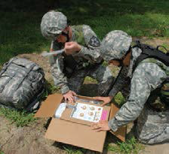
DLA Joint Reserve Force (J9)
J9 is made up of more than 660 trained reservists from the Army, Navy, Marine Corps and Air Force – ready and available for contingency operations and a broad range of support requirements to include:
Mission support to DLA supply chains
Surge capability
Joint exercise support
Planning augmentation
Defense support to civil authorities
Support to regional commands
J9 advises the DLA Director in the development and application of Joint Reserve Force capabilities, readiness posture, and service-specific policies affecting utilization of DLA-assigned reservists.
Notes:
J9, DLA Joint Reserve Force, is comprised of more than 660 Reservists. They provide trained, ready and available Reservists from the Army, Navy, Marine Corps and Air Force, to enable DLA to accomplish its worldwide combat support agency logistics mission.
J9’s objectives are to:
Develop an organization of highly skilled, multifunctional, joint logistics professionals who understand all aspects of DLA operations and customer service
Provide DLA with trained and ready Reservists who can mobilize and deploy to support DLA's worldwide mission
Integrate and build joint reserve capability to support a wide range of DLA operations and activities
Maintain compliance with Service-specific regulations and requirements to deliver maximum value to DLA’s military customers
As of June 2022

Slide 25



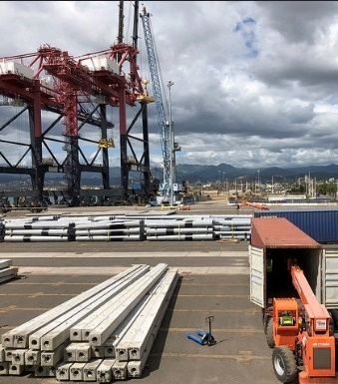


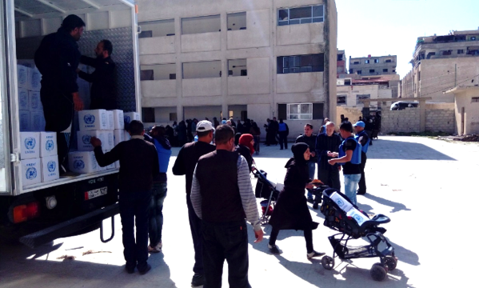


Whole-of-Government and International Partner
Support: 40 federal, 50 states, 300 local, and 124 international partners
2022 Year In Review
Defense Health Agency
$4.37B Pharmaceuticals and Medical
$11B
$5.1B Federal, state & local
$4.8B Other DOD partners
$1.1B Foreign military sales
Department of Health and Human Services
$2.12B Pharmaceuticals and Medical
Total Sales
Defense Security Cooperation
Agency
$1.12B Foreign Military Sales
Department of Veteran Affairs
$265M Medical / Surgical Support
U.S. Army Corps of Engineers
$197M Construction / Equip Support
Federal Emergency Management Agency
$49.9M Fuel/Generators/ISB Support
25
Notes:
DLA’s Whole of Government is a key Agency Line of Effort that aligns to SECDEF priorities on response to national needs, whole of nation, and economic interests
DLA provides supply chain management needs for the nation, while still meeting the needs of the military – Warfighter Always
Leverages economies of scale
Provides competitive acquisition and operating costs for all customers
DLA’s Whole of Government portfolio includes 40 federal, 50 states, 300 local and 124 international partners – also includes non-military DOD agencies
In Fiscal Year 2022, Whole of Government sales were $11 billion. 48% of FY2022 sales supported federal, state & local partners, 42% supported other DOD partner customers and 10% of sales supported foreign military customers.
As of February 2023

Slide 26








Whole-of-Government Partner (con’t)
2022 Wildland Fire Support
2022 All Hazard Support -FEMA
Supported
1M
$49.9M
$39.2M
322 Items
Batteries
Total Support & Costs
Total Support & Costs
166K
including
623K
3M
Meals
36
Critical Items
Fuel Gallons
$16.8M
Meals
0
$19.2M
at National Preparedness
Level 5
84
Portable Wastewater Treatment Plants
$8.4M
10
Leased Generators
days
Title 10 Force deployments
Longest recorded consecutive days at National Preparedness Level 5
$4.3M
41
91.3%
Multiple Training Exercises
Rate of Order Fulfillment
Deployed Civilians
Notes:
DLA’s global network and expertise in supply chain management enables an agile and rapid response to a variety of emergencies such as hurricanes, earthquakes, wildland fires, and foreign humanitarian assistance / disaster relief operations
In Fiscal Year 2022, DLA provided $39.2 million in support for wildland fires, supplying over 322 items, including 1 million batteries and 166,000 meals. DLA maintained a 91.3% order fulfillment rate, supporting 10 days of wildland fire operations at National Preparedness Level 5.
Additionally, DLA provided over $49.9 million in support for Fiscal Year 2022 hurricane relief efforts-FEMA, to include the deployment of 41 civilians for disaster response and 3 million meals, 623 thousand gallons of fuel and 84 leased generators.
Overall, DLA provides emergency response support in saving lives during national emergencies -- supplying tents, water, food, fuel, generators, fire-fighting equipment, medicines, and more.
As of February 2023

Slide 27
End of Slide Presentation

